Slide 1


Food Choosing, Table booking Restaurant Website.
Name: Emon MD WAHIDUZZAMAN
Student Id No: 201853082030

Slide 2

My website has total 6 pages including the home page. The page lists are given below- ✓ Home ✓ About ✓ Chef ✓ Menu ✓ Blog ✓ Contact
The header part you can also see a toggle button. That button represent a dark-mode on my website. If you like dark-mode, you can use and enjoy it as well.
Theme change button

Slide 3
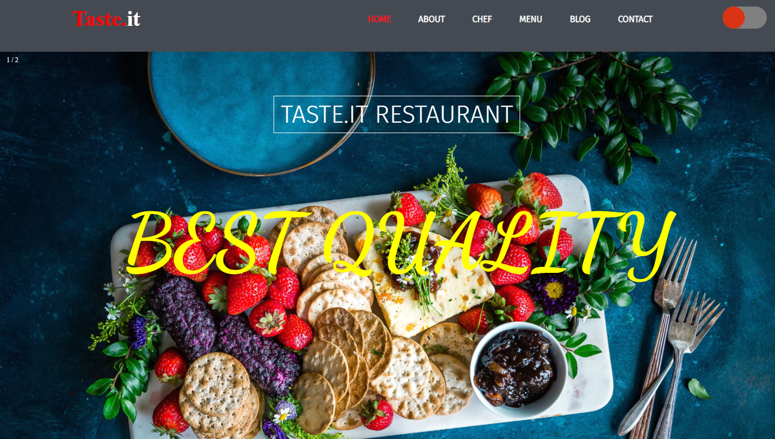
The header or Footer section is same for our all pages in the website.
Header Section:
After doing all of this, now it’s time to build it so I started with my home page navbar and an unordered list which is basically my other pages. I created the navbar gave it a nice color and shape and made all the list as my page and gave them nice effects for example, if you hover your mouse on the lists it will change their color automatically.
Then I inserted my restaurant name and linked it to all the other pages so that if you click on the name, it will take you directly to the home page. I also used a hover effect on the taste name. If you take your cursor on the name it will change the color and became white text to red. The header part you can also see a toggle button. That button represent a dark-mode on my website. If you like dark-mode, you can use and enjoy it as well.

Slide 4
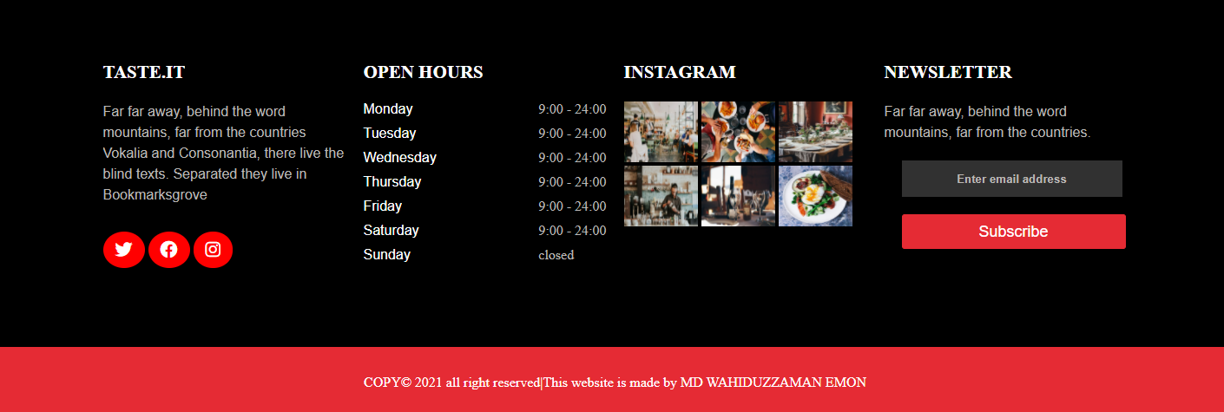
The header or Footer section is same for our all pages in the website.
Footer Section:
The footer section you can see some social icons. If you click that icon you will go to our restaurant Twitter, Facebook or Instagram page site. There also have the date or time to know when our restaurant will be open or close. Then also Instagram images of our foods and also a subscribe button for our YouTube channel.

Slide 5
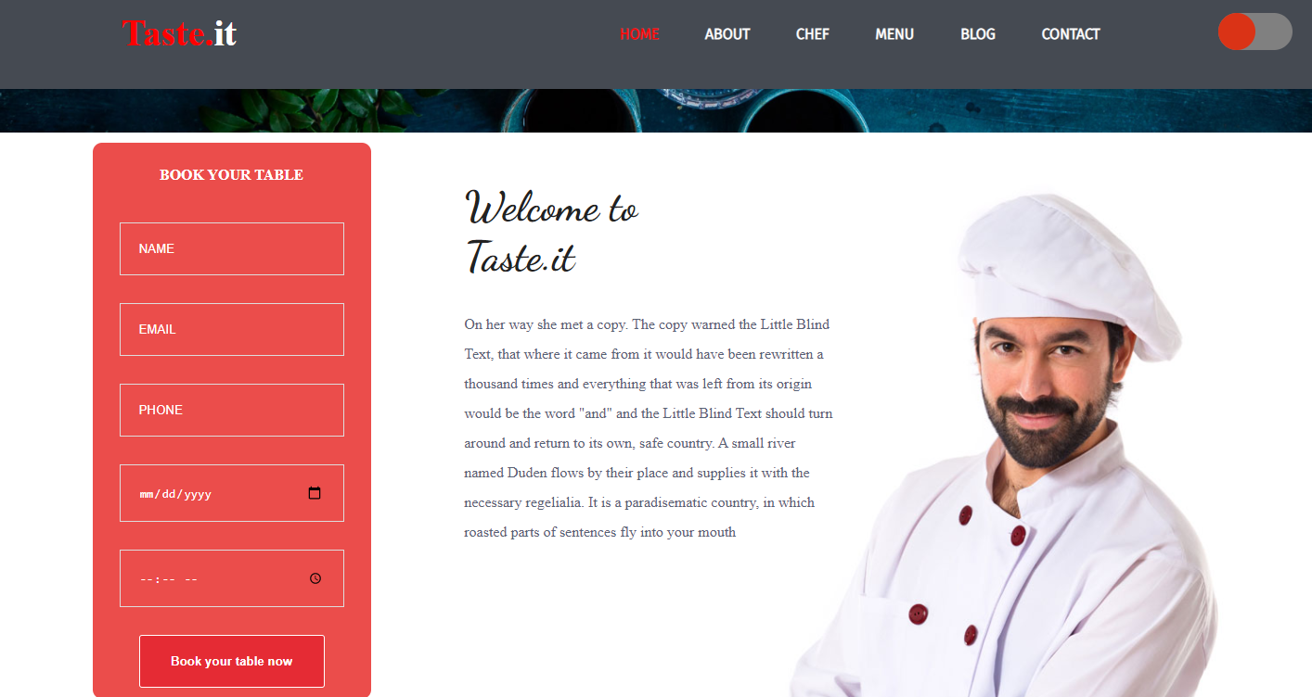
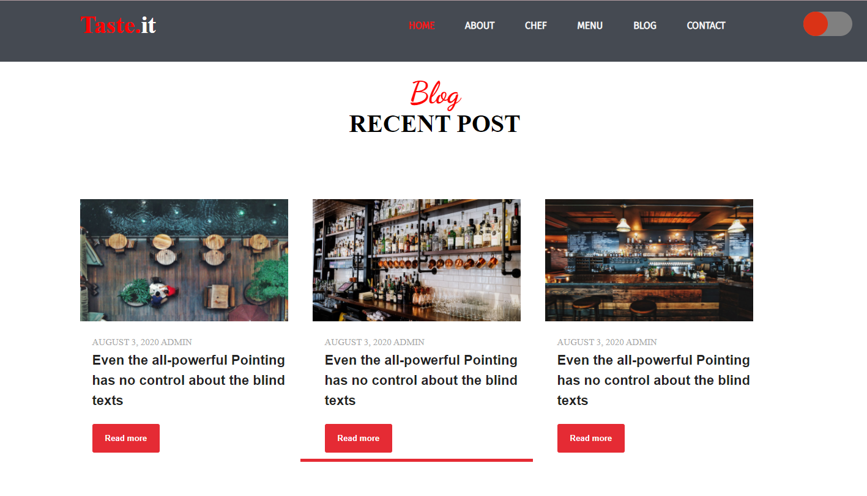
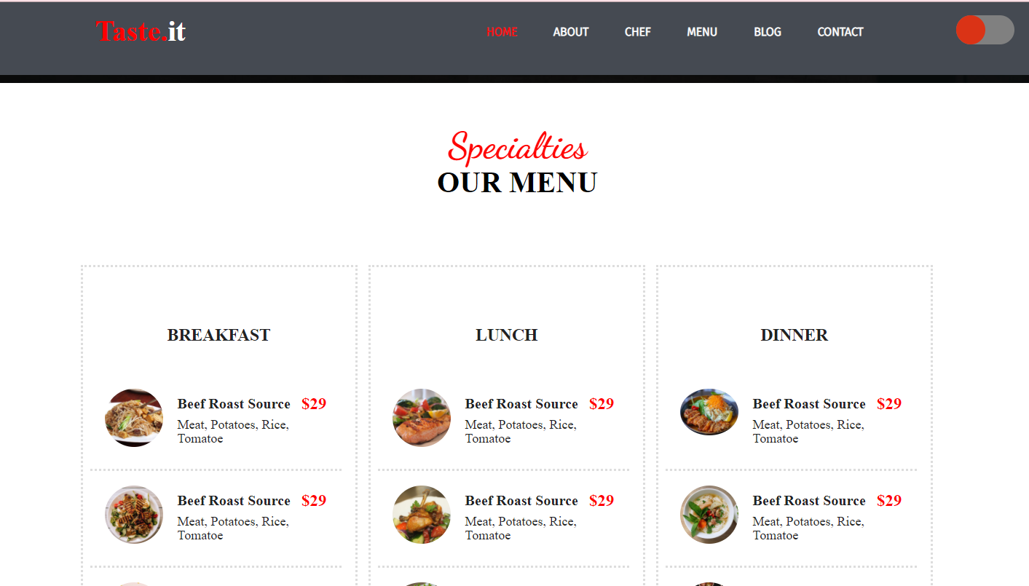
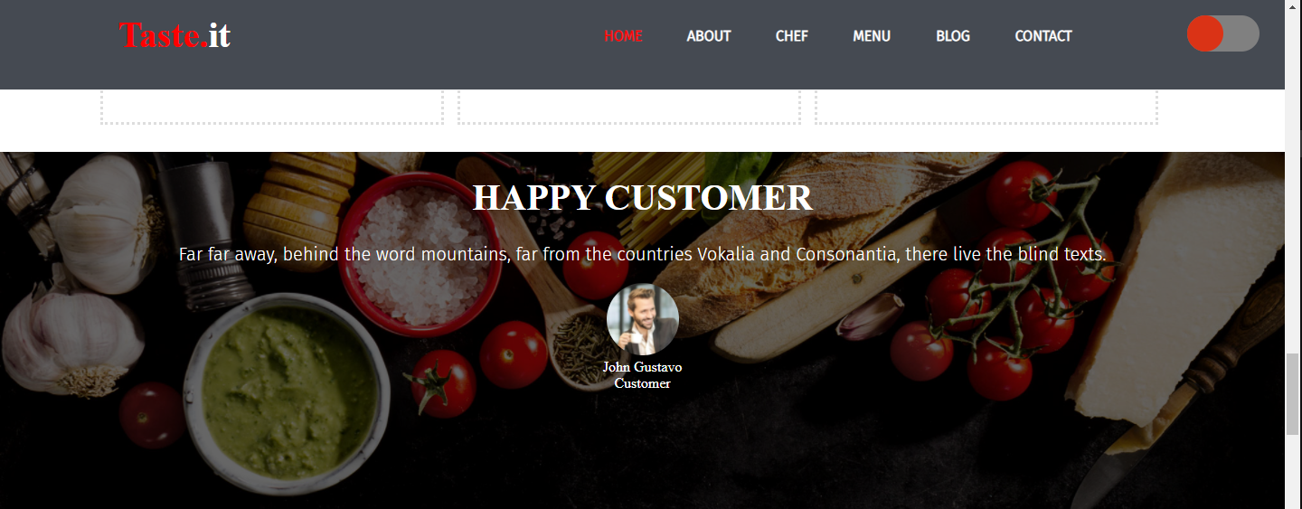
HOME PAGE: After header section I use a slider image with a text and it works with JavaScript. As your requirement I used table where left side I used a form and right side content contains about the restaurant. That form is use for booking a table. You can fill the form and submit then you can see a popup window. For that I use JavaScript that our website looks like a dynamic. Then you can see various special food items to our restaurant. Which is breakfast, lunch or dinner and also had various items. Then you can see a slider which is for showing our customer review. Then you can see our master chef details with their bio and picture. Then we have a blog section for our website. You can see the recent blog on home page. After blog section we have also a table booking option

Slide 6
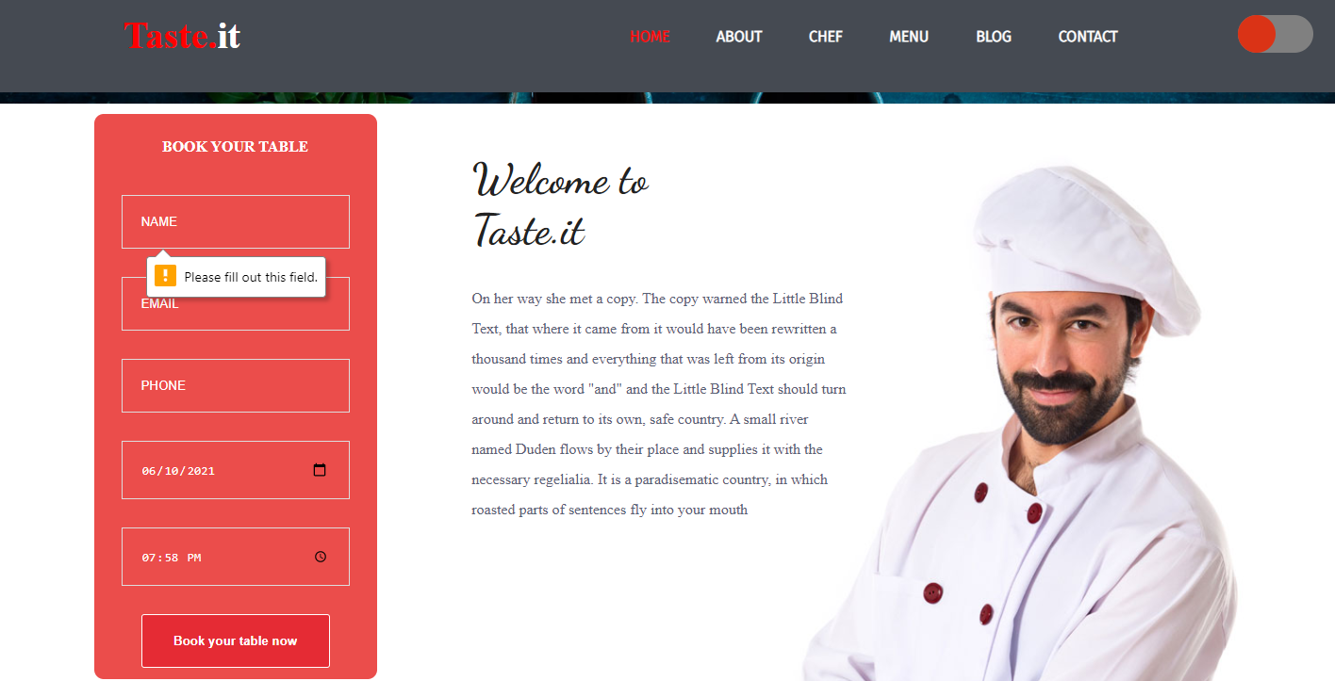
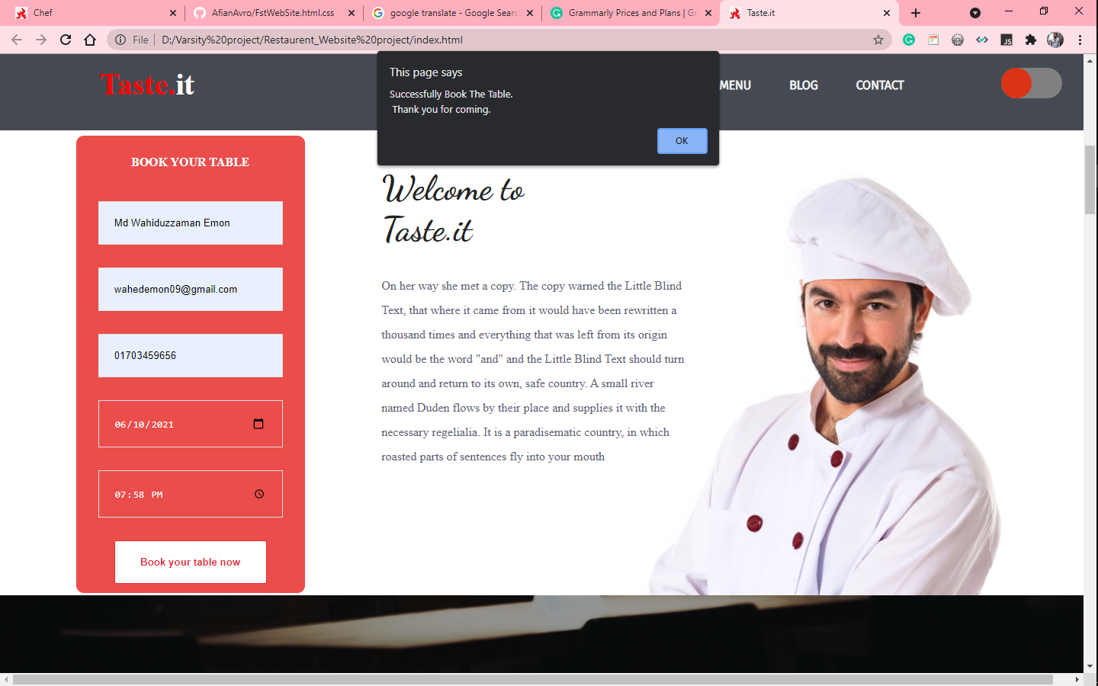
In this website all of form are give you response. Like, if you don’t fill all the fields, it will say first to fill all of them. Otherwise you can not submit the form value.
As you can see the first picture----
Then if you fill all the fields you can able to submit the table booking form. And it also show the popup message after submitted the form.
As you can see the first picture----

Slide 7
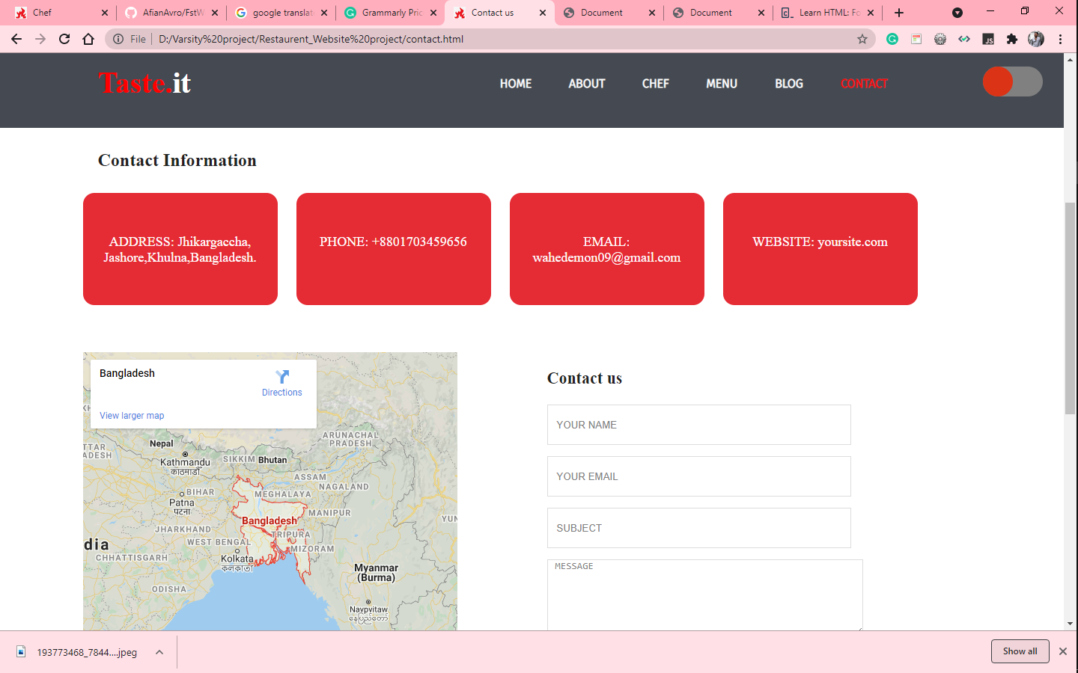
This contact page has Address, Phone, Email, and Website. Also have location checker/map, and feedback form .

Slide 8
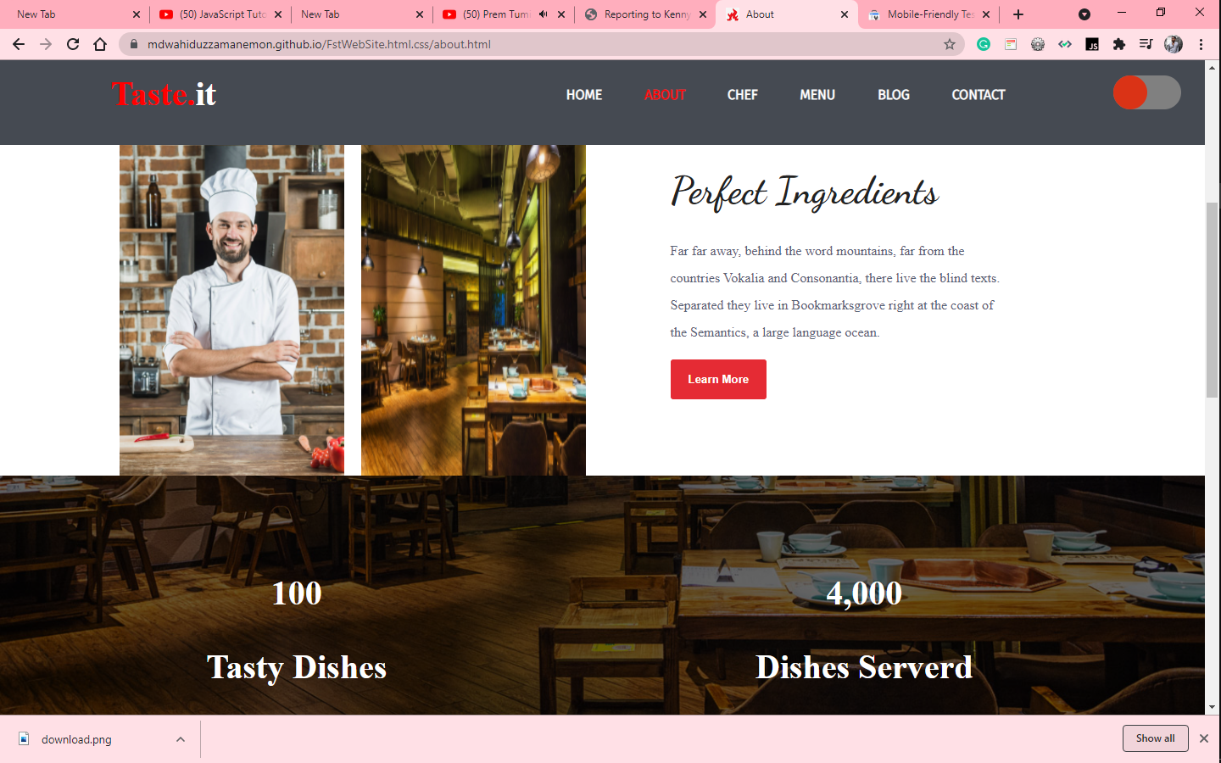
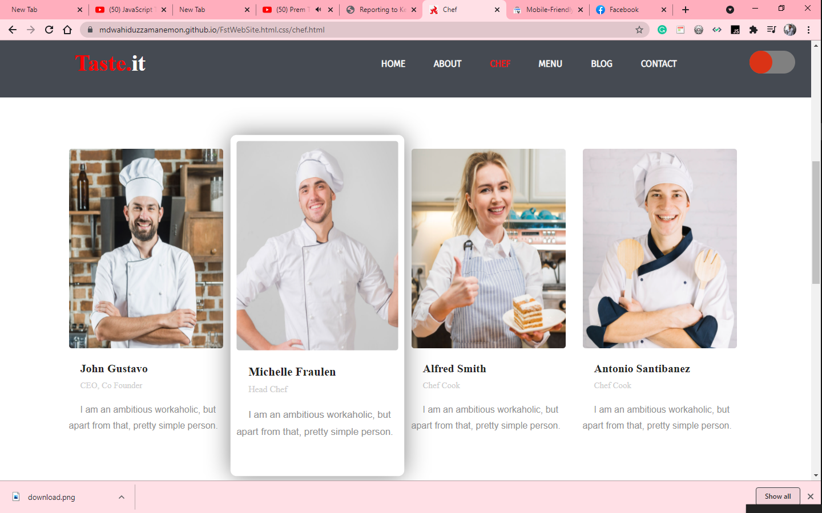
About/Chef : In this page , you can see the perfect ingredients details, how many tasty dishes, dishes served amount.
Also you can see chef page our famous stuff here .If you take your cursor on their then that will be hover and transform scale.

Slide 9
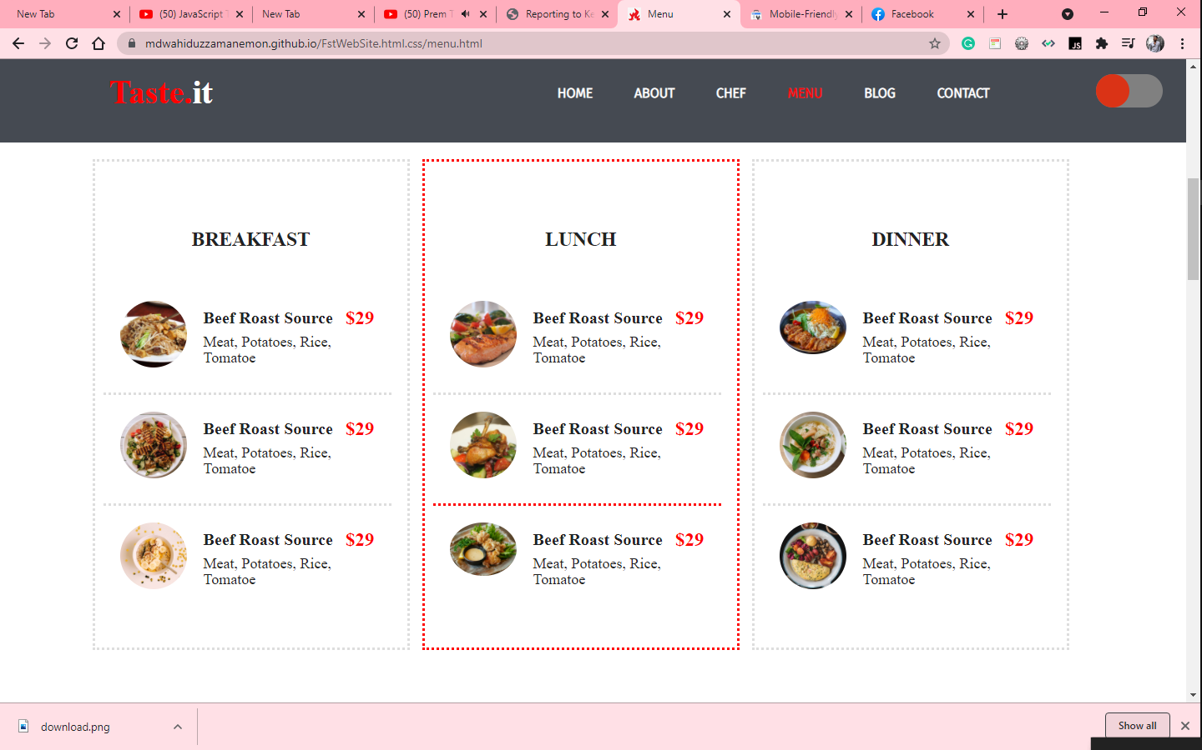
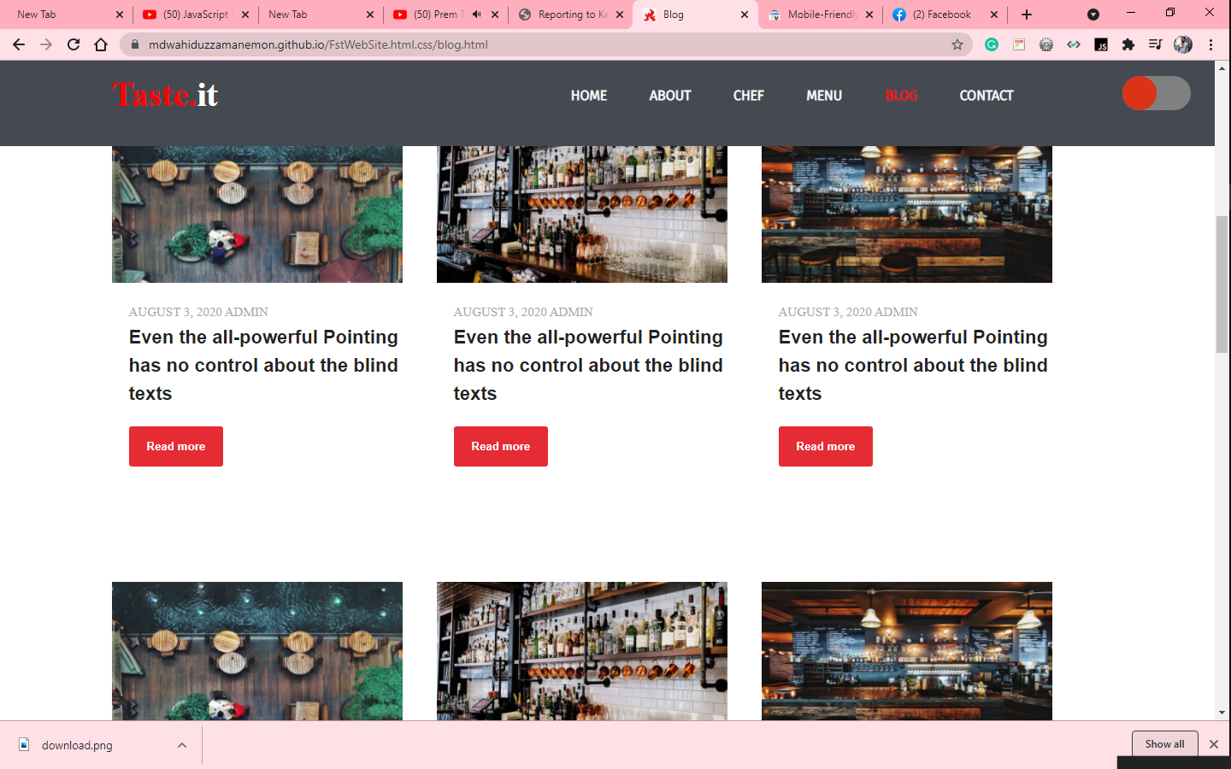
Menu/Blog:
Menu page has different food menu. And when you can take which food, you can see that there and also get food prices.
Other side Blog page has also food blog, food reviews, and about our restaurant details which is very important to know the image or quality of my website.

Slide 10
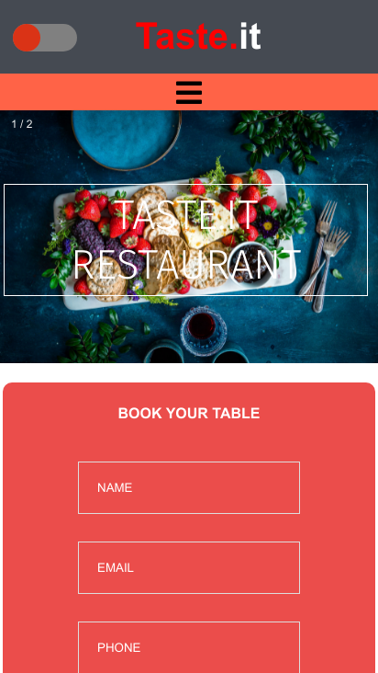
MOBILE VIEW
You can use this website also mobile devices .Mobile mode has also dark mode .

Slide 11
That’s all for This Website.
Thank You

